Slide 1
Evolutionary Optimization Algorithms
Raymond Huang | Armaan Mehta | Holiday Han
Yunruih2 | Armaanm3 | Ziyinh2
ME 447 Project 3

Slide 2
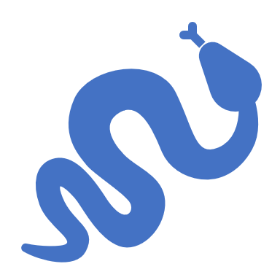
Table of Contents
Objective
Snake force implementations
CMA-ES implementation
Optimization of the pure wiggling case (CMA)
Optimization of the pure twitching case (CMA)
Optimization of the combined case (CMA)
Comparison and Conclusion

Slide 3
Objective
After implemented the computational soft mechanics code and construct a near-realistic model of a slithering snake and use CMA to find gait parameters that maximizes the forward speed, under given conditions in project 2, we want to have a more real-life soft mechanics model based on the snake we have already had.
This project is created for studying the effect of wiggling in snake gaits. In real life situations, when a snake moves, it does not only slither due to movements created by muscle torque, but it also extends and shrinks, what we defined as wiggle. We want to optimize the gait with CMA to find which combination of wiggling and slithering maximizes the forward speed? That is what we are studying in this project.

Slide 4
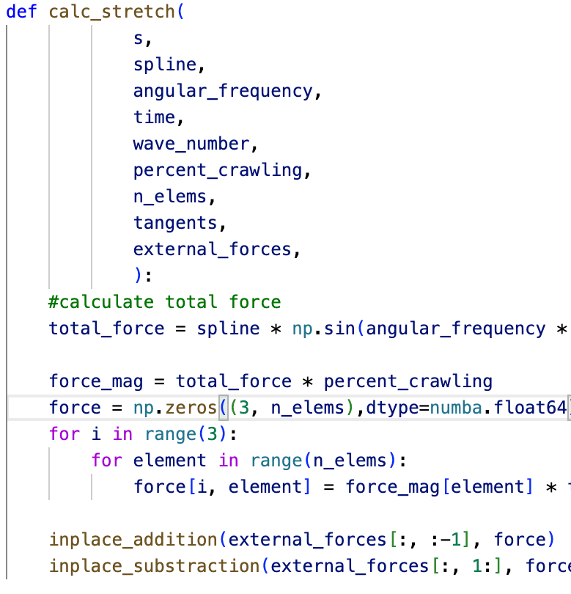
Snake force implementation - stretching
We defined the stretching force in our project as shown on the right
Total force has a magnitude given by its normalized length based on the Beta spline coefficients
The snake choose between crawling and slithering, percent_crawling means how much percent of force is used to generate stretching force that results in wiggling.
Stretching is an internal force, therefore perform in place addition for the tail nodes as they are pulled forward, and in place subtraction for head nodes as they pulled backwards by reaction forces.

Slide 5
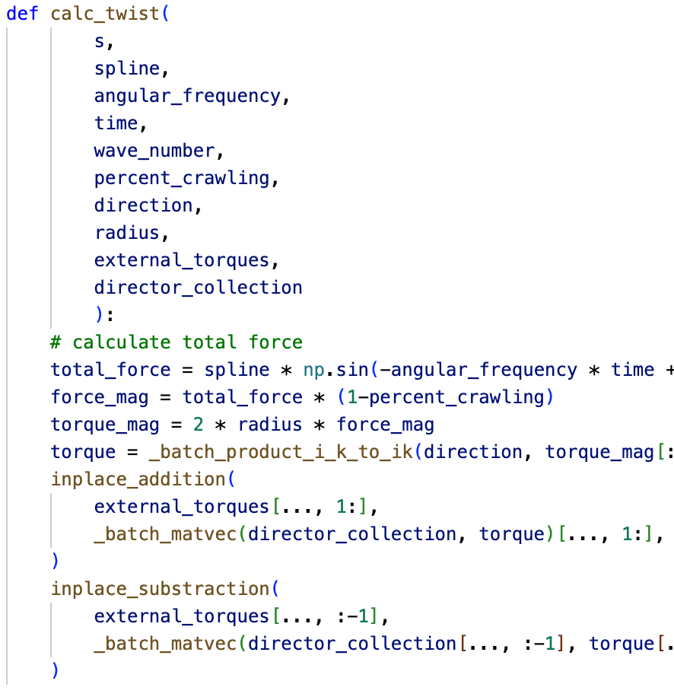
Snake force implementation - slithering
We defined the twisting torque in our project as shown on the right
As the snake contract its muscle, unbalanced force on the sides create force couples, thus generating torques.
We assume the forces are equal and opposite direction on the two side of the snake, therefore there is a moment arm = diameter of the snake
As this is an internal torque, we need in place addition and subtraction with the same reason we do for the stretching force.

Slide 6
CMA-ES Parallel implementation
We implemented the CMA evolution strategy as described in the paper and project 1
Termination criteria were implemented which improves the speed of the algorithm as it stops when the algorithm has reached an optimum solution or if an indicator exists hinting to the algorithm not converging at all saving computational time and cost
We implemented a function called parallel_sort() which utilized all cores and sorted the population based on the fitness function in a more efficient manner
Using multiprocessing, we were able to parallelize the process of finding the fitness values across all cores in each population member before combining that information to sort the population
Increased the speed of CMA-ES for our implementation ~5.5x on a 6-core laptop allowing us to increase popsize and sigma
This meant that the optimized solution had a far greater likelihood of being the most optimum solution that existed within our boundaries defined in the fitness function

Slide 7
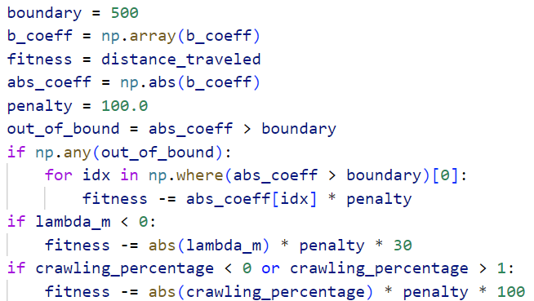
Defining the fitness function
The fitness function returned the speed of the snake across all axes in m/s
A penalty system was applied if the b-spline coefficients or the wavelength exceeded or went below a value as shown beside
This allowed us to constrain the parameters in an efficient manner
A penalty system was deemed better than returning zero as the fitness as we would have to increase pop_size if we chose to do that
The CMA-ES_Parr function optimized for the largest fitness therefore maximum speed

Slide 8
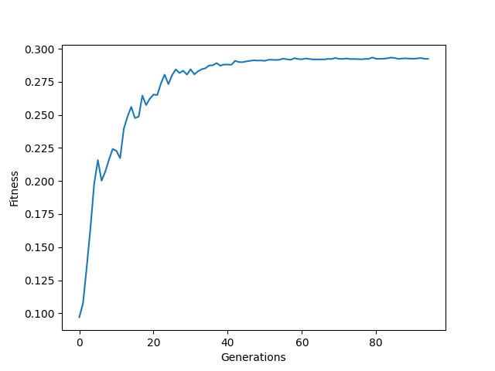
Optimization of the pure wiggling case (CMA)
Initial Sigma = 30, Population size = 50, Max_Generations = 250, % Crawling = 100
Solution: b_coeff = [ 0, -150.19929554, 499.68705001, 499.708699, 489.26091413, 0 ], wave_length = 285.0082 cm
Fitness: 0.163 m/s
Terminated in 95 Iterations (NoEffectCoor)

Slide 9
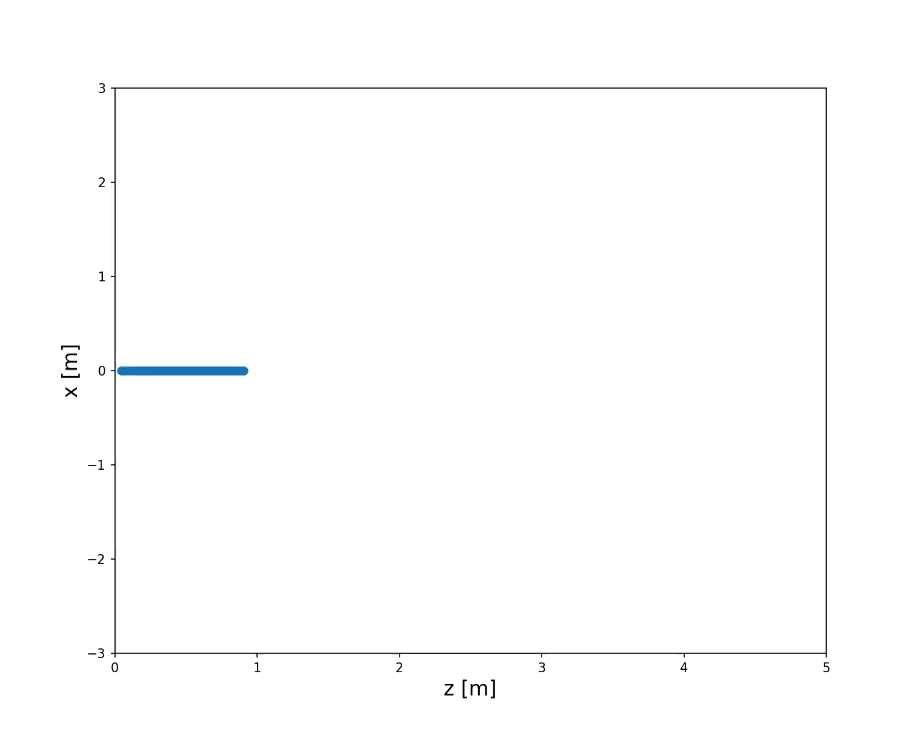
Optimum gait of the pure wiggling case (Results)

Slide 10
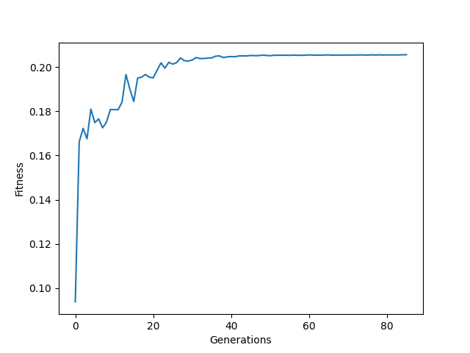
Optimization of the pure twitching case (CMA)
Initial Sigma = 30, Population size = 50, Max_Generations = 250, % Crawling = 0
Solution: b_coeff = [ 0, 135.65041025, 211.66918051, 499.5960613, 498.99765331, 0 ], wave_length = 147.94281119 cm
Fitness: .223 m/s
Terminated in 87 Iterations (NoEffectCoor)

Slide 11
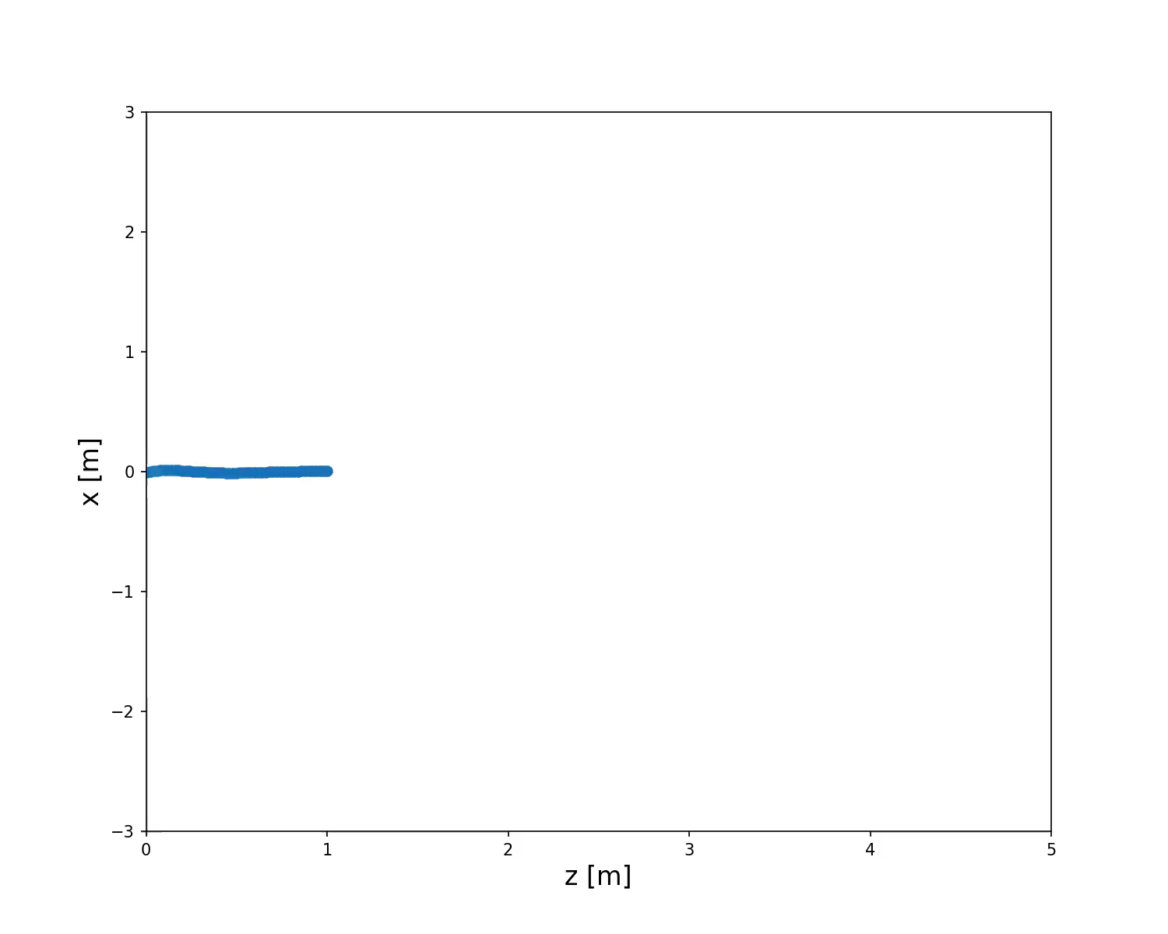
Optimum gait of the pure twitching case (Results)

Slide 12
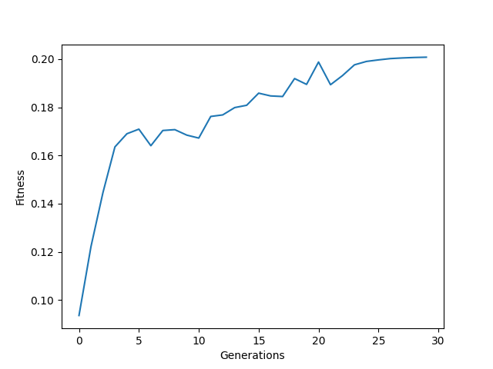
Optimization of the combined twitching and wiggling case (CMA)
Initial Sigma = 30, Population size = 80, Max_Generations = 250
Solution: b_coeff = [ 0, 1.17293510e+02, 2.86312534e+02, 4.30534094e+02, 4.85093523e+02, 0 ], wave_length = 1.49971895e+02 cm
Fitness: 0.219 m/s
Terminated in 28 Iterations (ConditionCov)

Slide 13
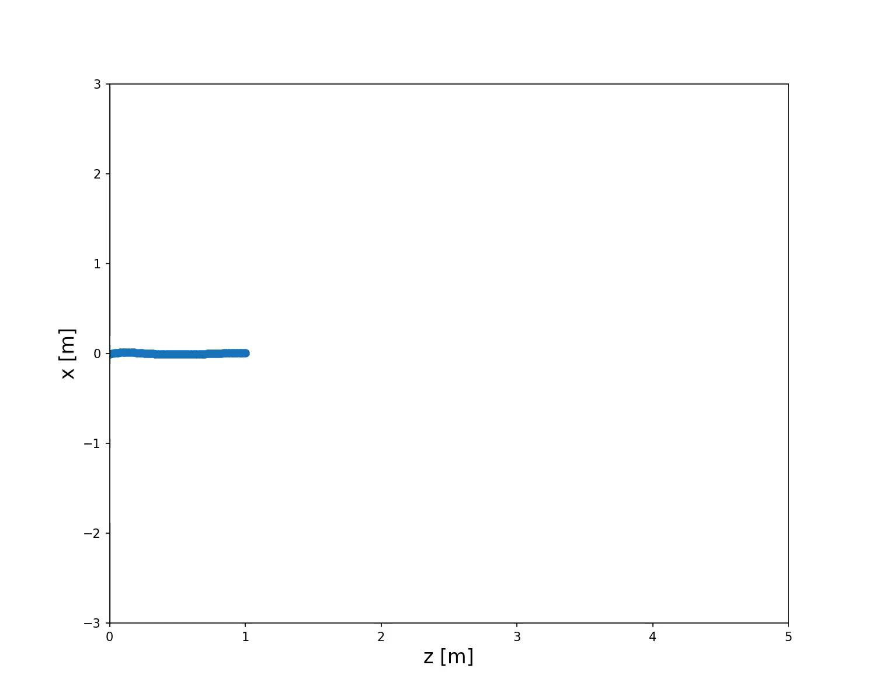
Optimum gait of the combined twitching and wiggling case (Results)

Slide 14
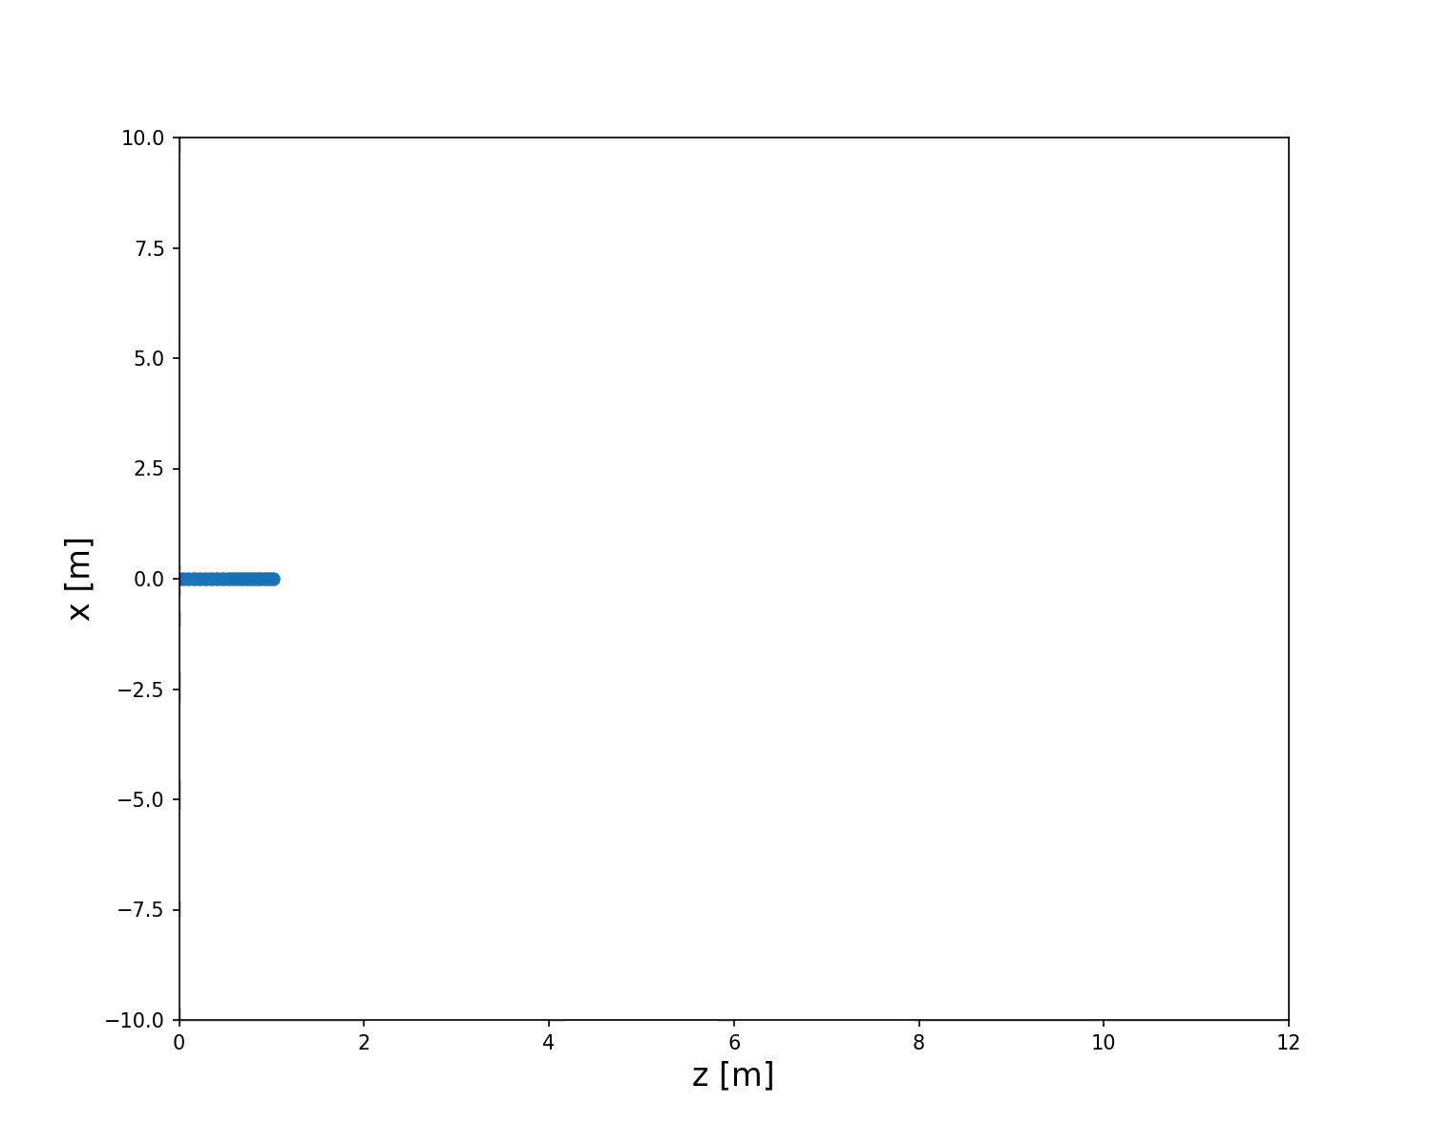
Extra: Optimization of the Muscular Activation Period (CMA Results)
An extreme case where we also optimized for muscular activity period (with no restriction) and assumed very small forward kinematic friction (1/10 of original) while friction in other directions under different conditions remains the same.
This shows that wiggling dominates the gait when forward kinematic friction is small.

Slide 15
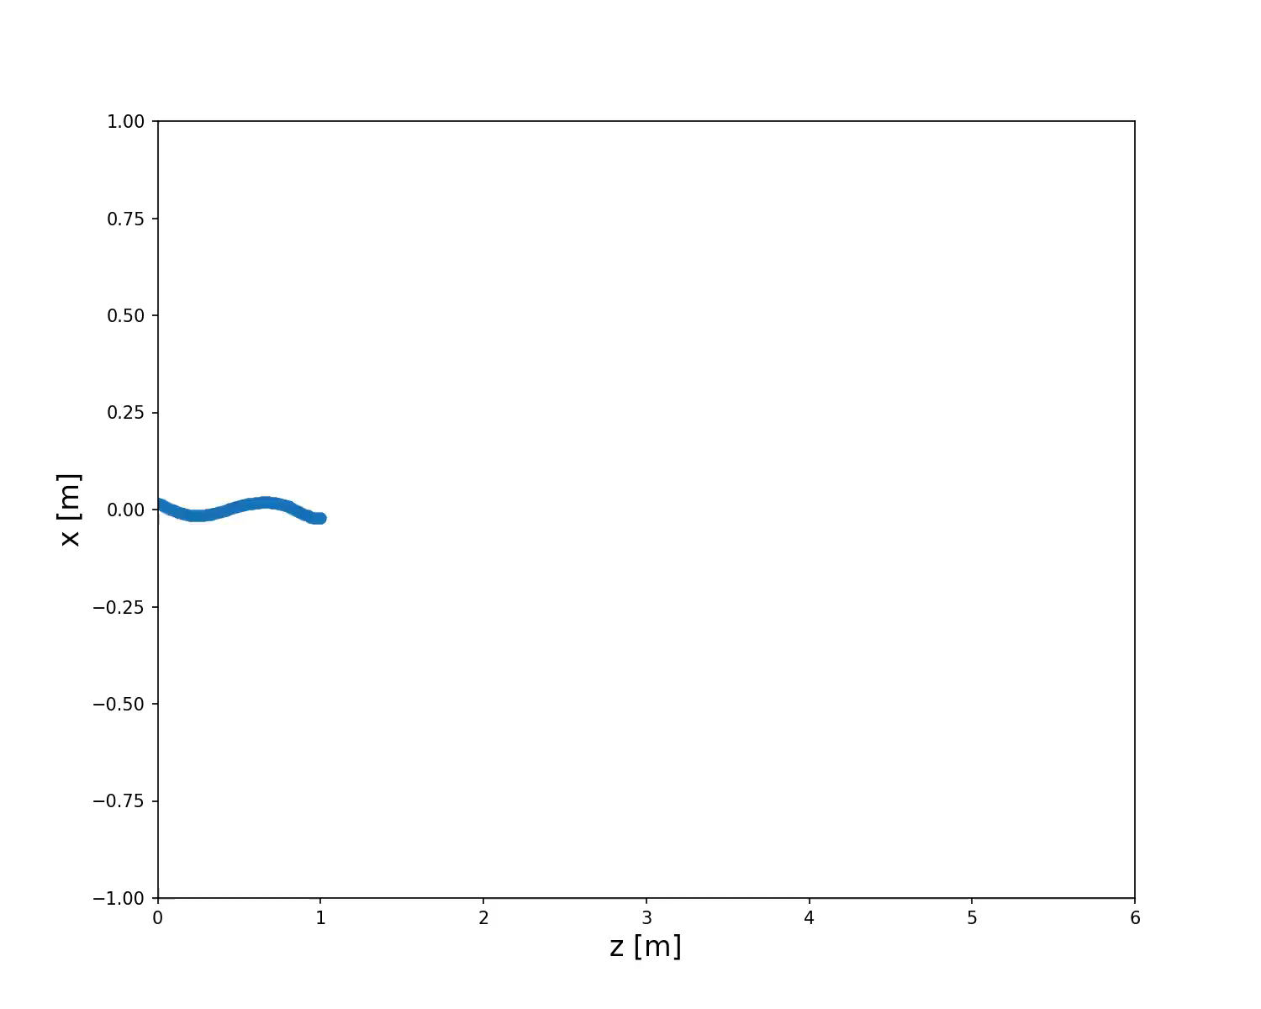
Extra: Rattle Snake (CMA Results)
Assumptions: A rattle snake lifts its body when it is going forward
Therefore, the forward kinetic friction must be significantly lower
A rattle snake must have optimized its muscle so that the period of muscular activities are perfect optimal for their crawling speed within reasonable range.
Assume the forward kinetic friction is 1/4 of original
Assume the muscle over the whole-body contracts with a period at least 0.25s.
In this case, forward kinetic friction is attenuated but it is still present, so slithering is optimum for the snake.

Slide 16
Comparison and Conclusion
Wiggling and slithering alone make sense, wiggling is slightly slower than slithering.
We coded the CMA to stop when the result converges, but the convergent condition parameter is not big enough for the combined result to converge good enough.
When there is enough forward kinetic friction present, the optimum gait for the snake is slithering.
When there is little to no forward kinetic friction present, the optimum gait for the snake is wiggling.

Slide 17

Future Work
Increase conditionCov limit value to 10^14 to achieve more accurate results for the combined case
Distribute parallel optimization of CMAES across multiple machines to further reduce computation time allowing us to search a larger space in less time with more precision (using Dask or other libraries)
Further investigate the rattle snake and muscular activation period in relation to other parameters
Study the relationship between crawling percentage and forward kinetic frictions

Slide 18

The End. Thank you for listening

